Slide 1
Software Engineering Project Presentation
Group 3
Alessio Pepe - 0622701463
Dario Zito - 0622701512
Paolo Mansi – 062271542
Teresa Tortorella - 0622701507

Slide 2
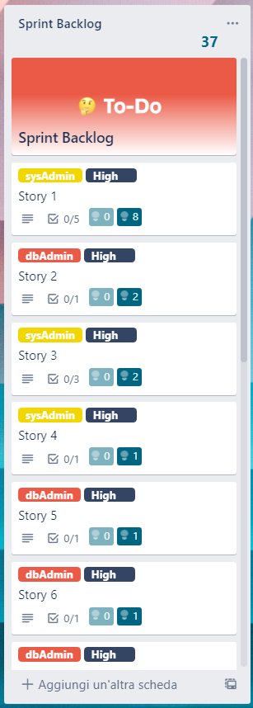
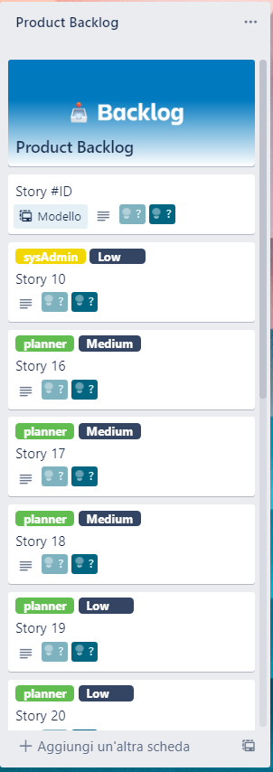
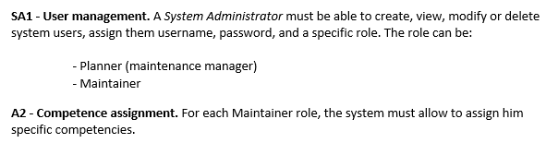
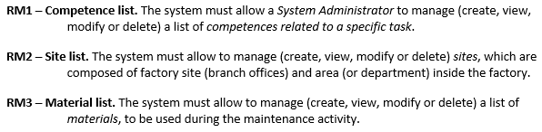
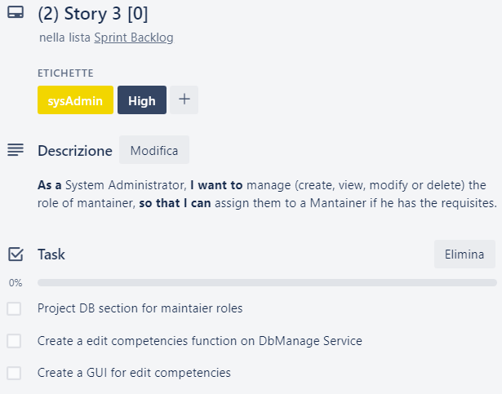
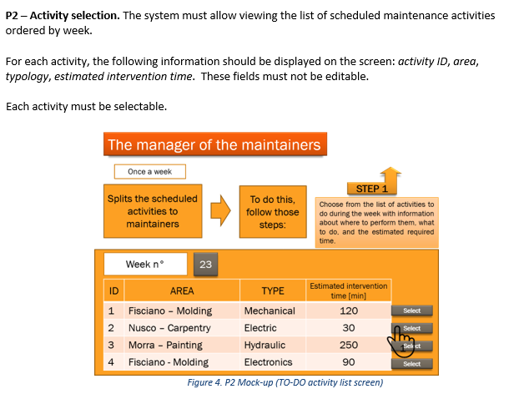
SCRUM and Requirements

Slide 3
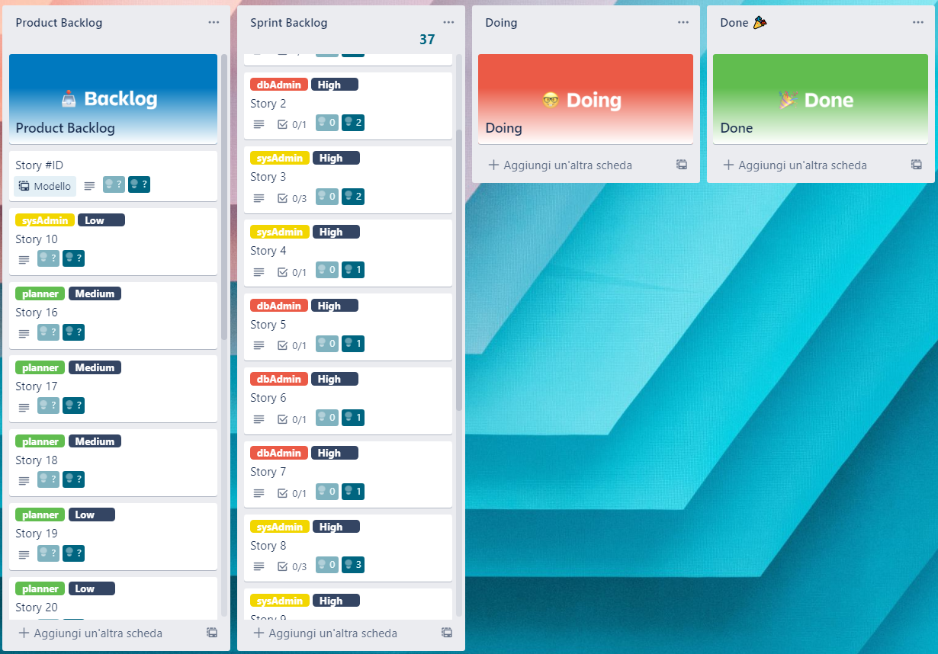
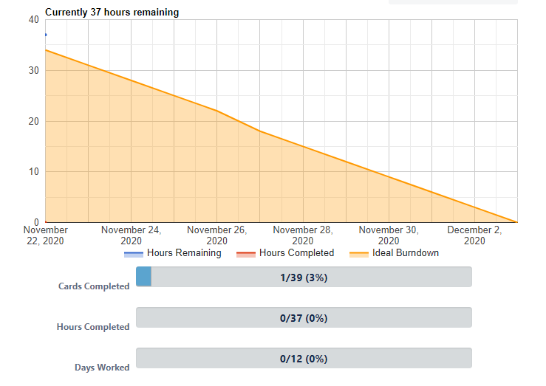
SCRUM and Requirements

Slide 4
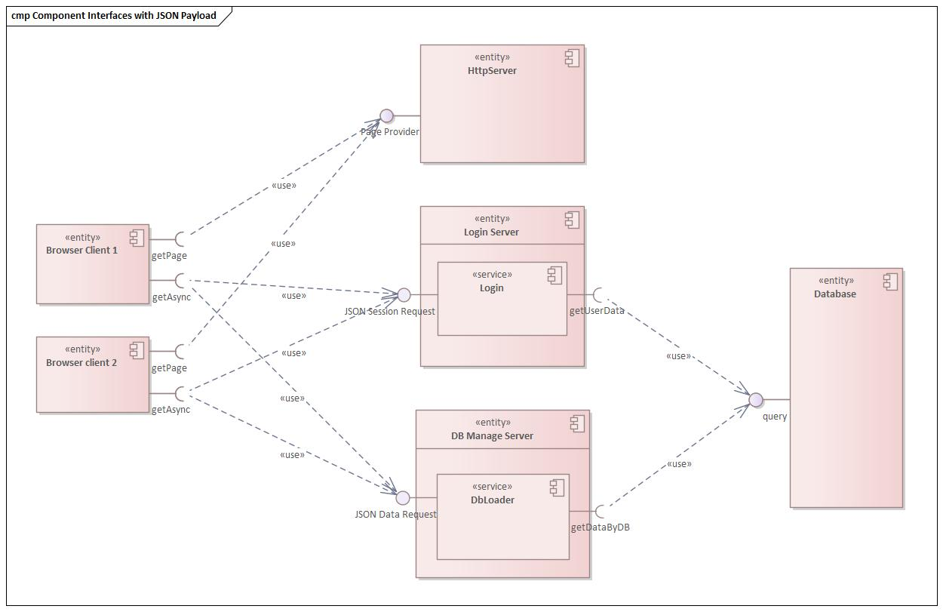
Tecnologies & High level design draft

